Slide 1
Victor Martinez
The Dream of the Anti-fragile Systems

Slide 2
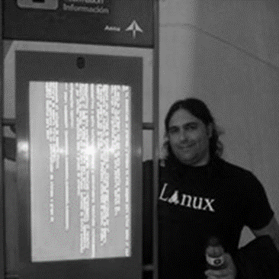




about me
Systems Architect in Versia Emerging Technologies.
Degree in computer engineering.
Studying A Degree in Environmental Sciences.
linkedin.com/in/victor-martinez-bahillo
@vthot4
DevOps-Norte: https://t.me/joinchat/AXWT6U1scua78GWHqVzUTA

Slide 3
Question
What kind of systems do we want to have in ten years?

Slide 4
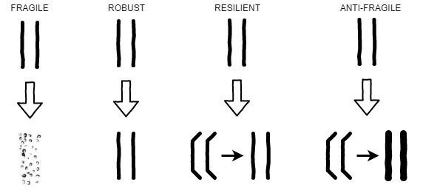
Types of Systems

Slide 5
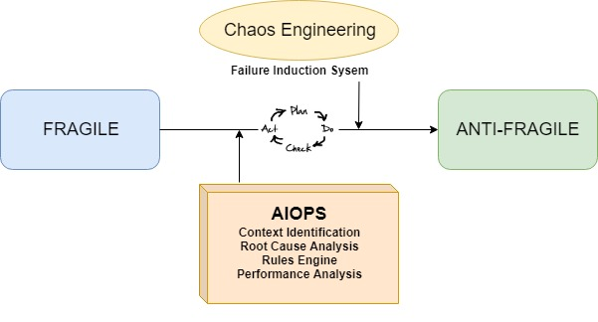
General scheme

Slide 6
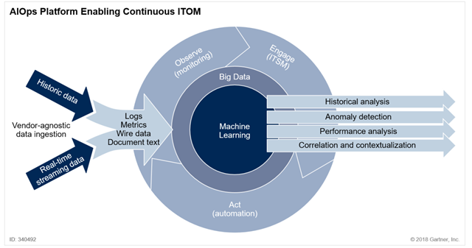
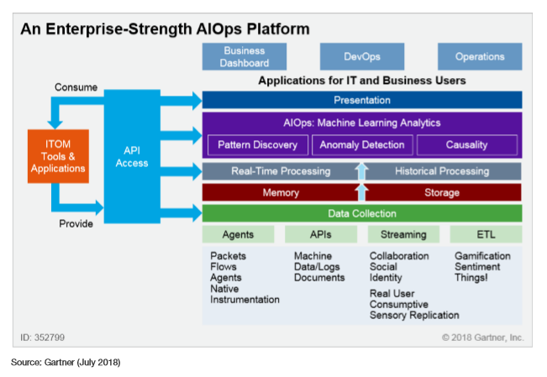
Components. AIOPS
Source: Gartner (November 2018)

Slide 7
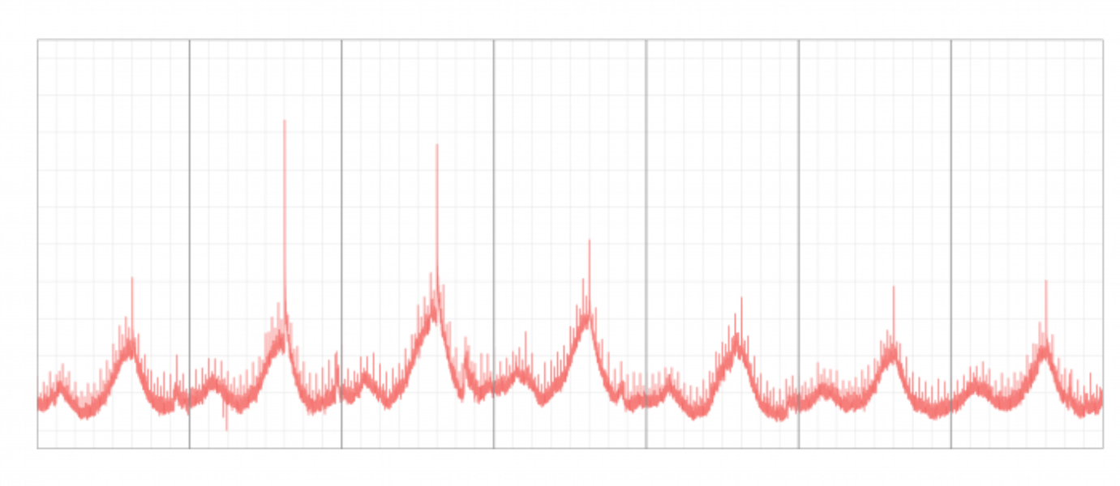
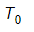
Components. Time Series

Slide 8
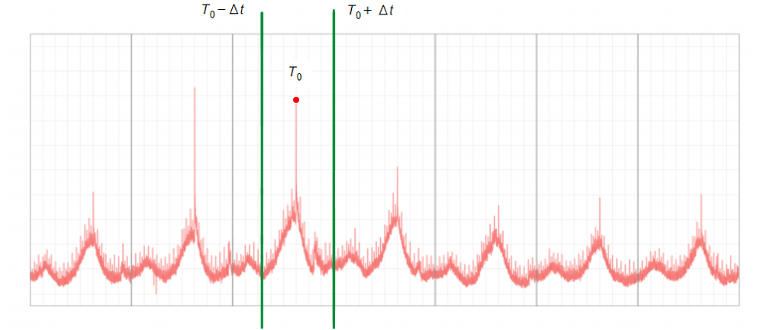
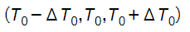
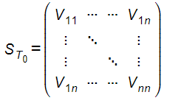
Components. Time Series
Context Identification
OBSERVABILITY

Slide 9
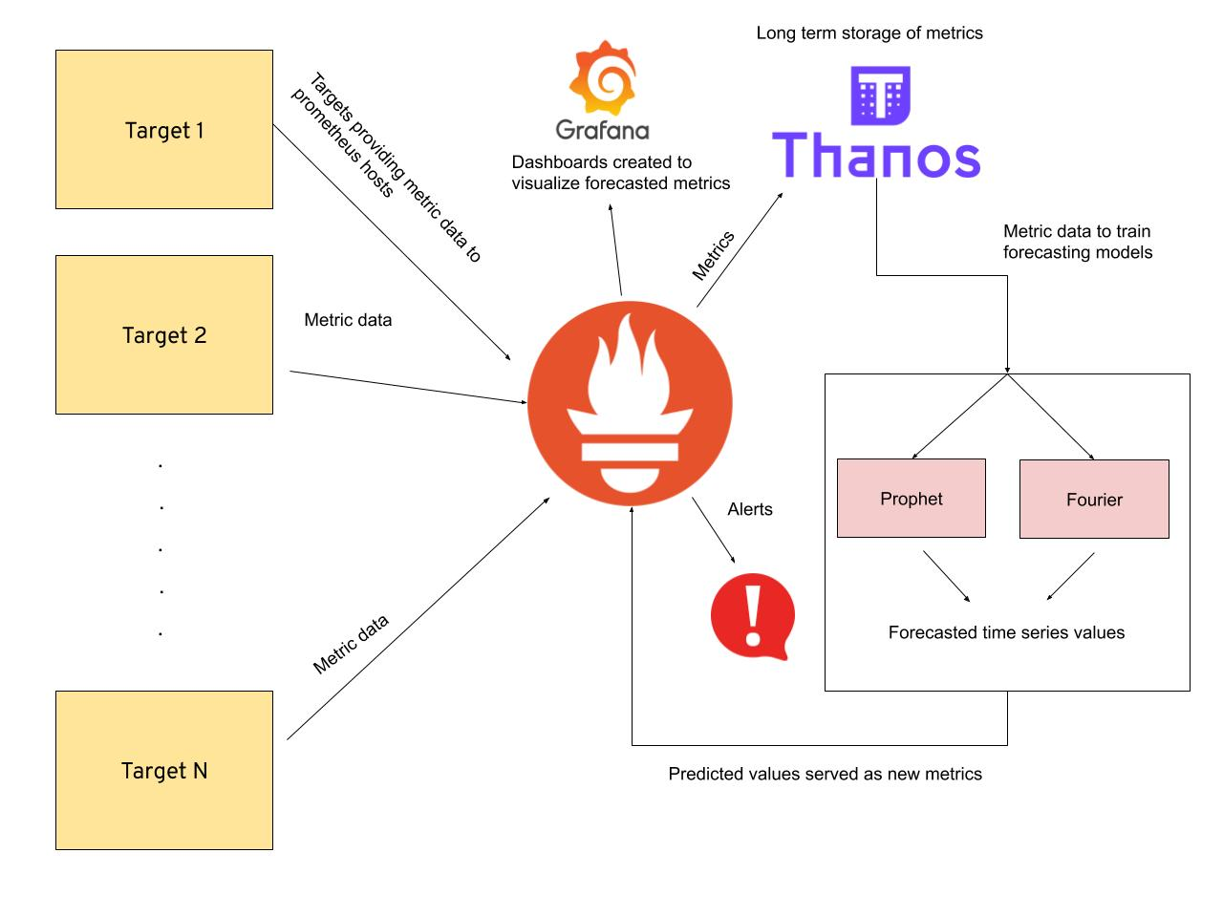
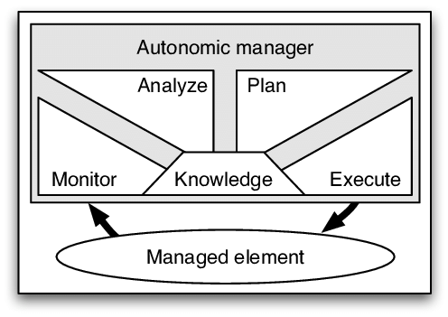
Components. AIOPS
MAPE-K BY IBM
Source: https://github.com/AICoE/prometheus-anomaly-detector

Slide 10
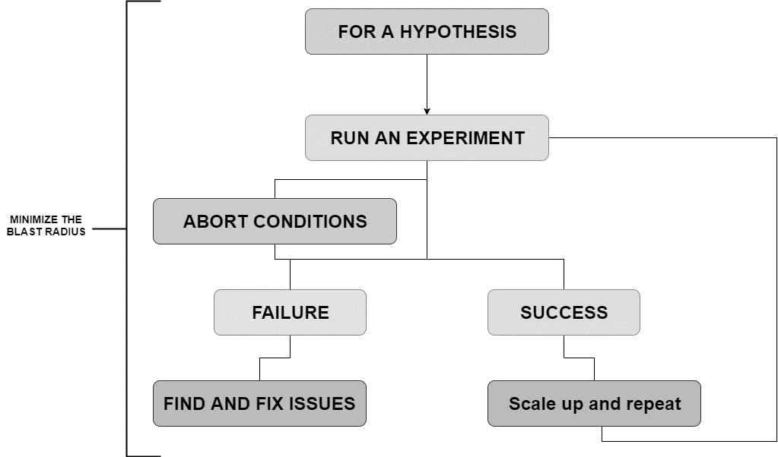






Training the Systems.
TOOLS
Source: https://www.slideshare.net/AnaMedina42/velocity-london-chaos-engineering-bootcamp

Slide 11
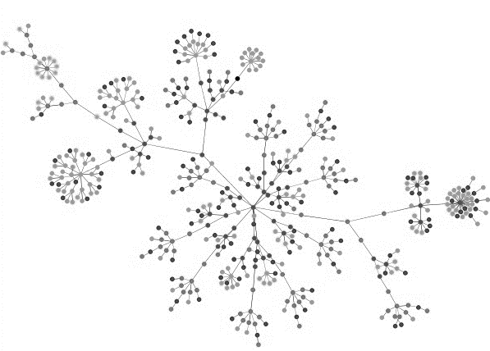
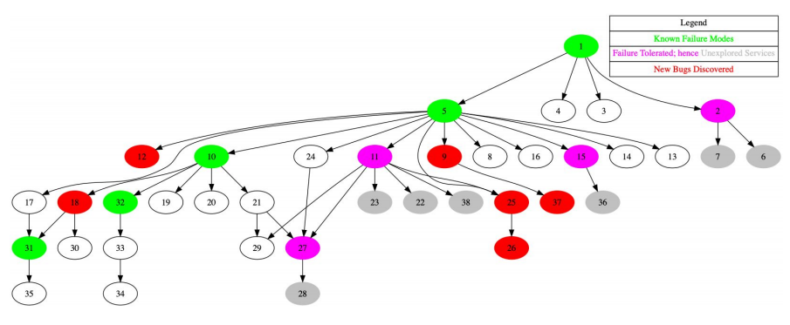
Training the Systems.
Source: https://www.usenix.org/sites/default/files/conference/protected-files/sre19amer_slides_raina.pdf

Slide 12
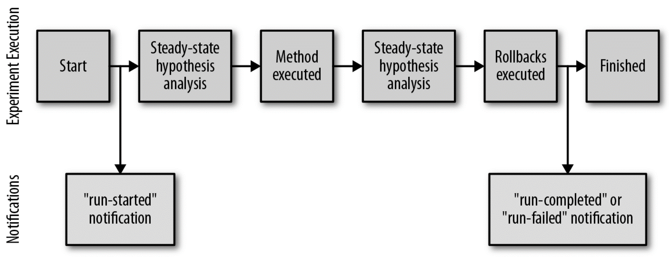
Training the Systems.
The notifications available from a chaos experiment’s execution
Source: Chaos Engineering Observability Bringing Chaos Experiments into System Observability. O’REILLY.

Slide 13
Questions
How to narrow the system’s training, to avoid performance issues.
Issues related to the stationary operation, those timeframes where the system needs to behave in a different way to what we understand as normal operation.
Minimize operations costs.
Enhance the context detection mechanisms.
Conflicts between the solutions provided to the events.

Slide 14
Final Conclusions
Anti-fragile systems can help us improve our systems.
Anti-fragile systems do not only resist the damage, but get by improved.
AIOps and Chaos engineering could be two key components in these systems development.

Slide 15


